Slide 1
ANCIENT GREEK CIVILIZATION
18th Primary School of Rhodes
30/05/2022

Slide 2
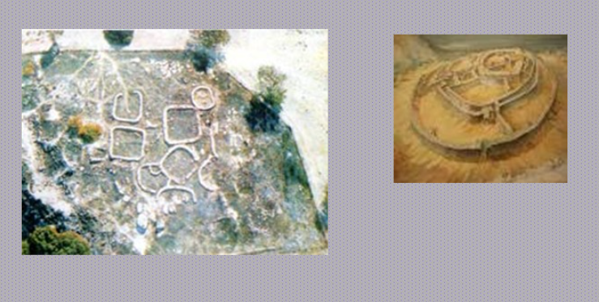
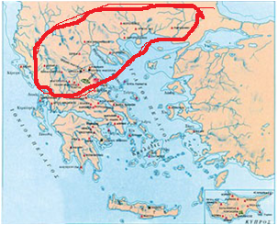
Greek History
THE STONE AGE
First proof of human life in Greece is dated since Palaeolithic period between120.000-10.000 B.C.
Macedonia-Thessaly-Epirus

Slide 3
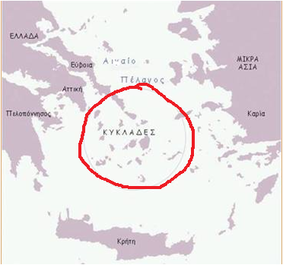
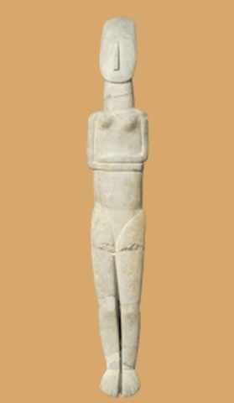
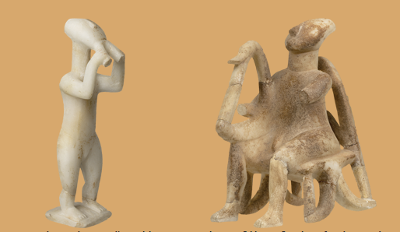
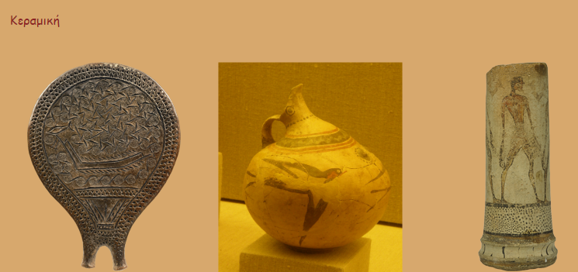
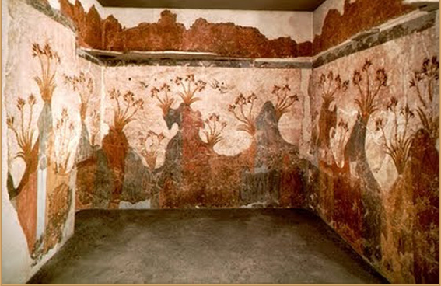
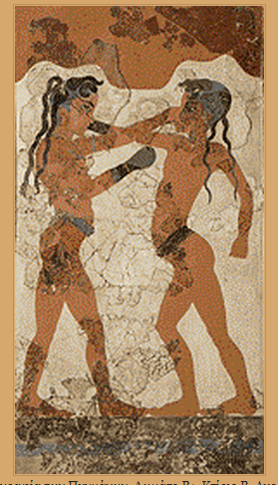
BRONZE AGE – 3.200 – 1100 B.C.
Cycladic Culture 3.000 – 2.000 B.C. – Art – Idols – ceramic – wall painting

Slide 4
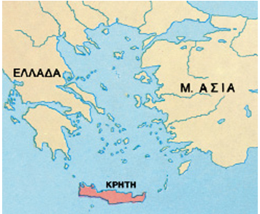
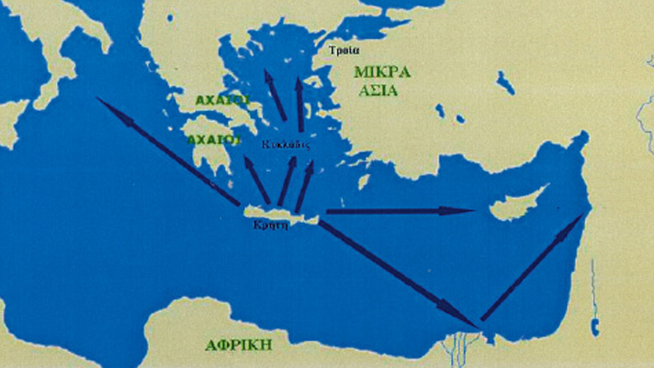
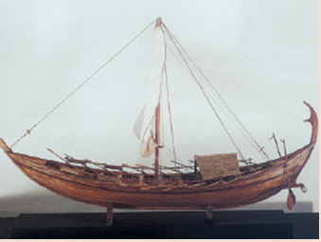
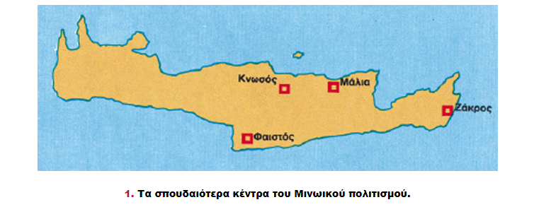
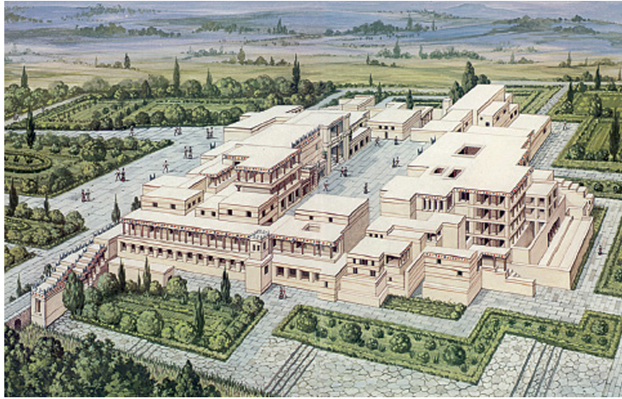
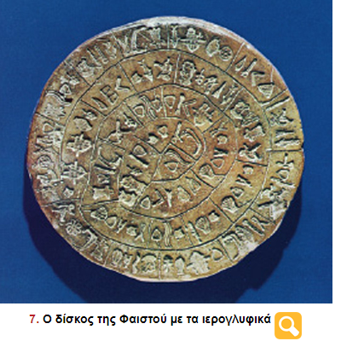
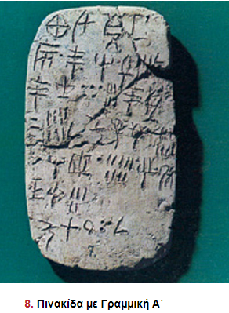
BRONZE AGE – 3.200 – 1100 B.C.
Minoan Civilization 3.000 –1.375 B.C.
It was born in Crete
It was named Minoan after the mythical king Minos, the son of Europe and Zeus
Crete was a great naval and commercial power - they sold oil, honey and wine vessels, jewels and seals. They also brought gold, silver, bronze, ivory and valuable stones.
“Minoan dominance at sea”
Knossos Palace
Phaistos Disc
Sign with Linear A’

Slide 5
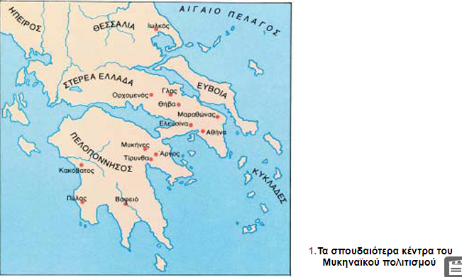
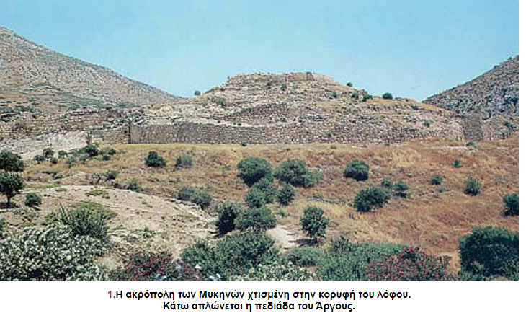
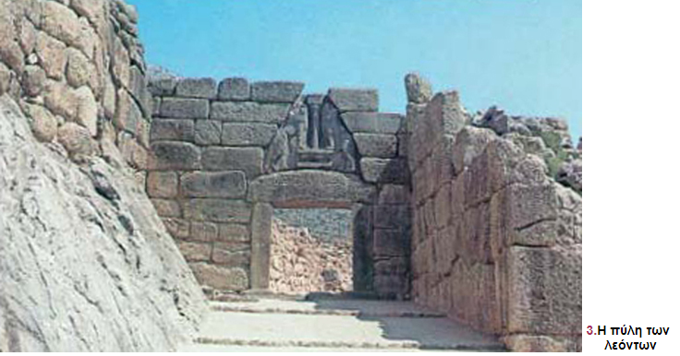
BRONZE AGE – 3.200 – 1100 B.C.
MYCENAEAN CIVILIZATION 1.700 – 1.100 B.C
«Achaeans» came from the north and stayed in Central and Southern Greece. They were the first Greeks.
It was named after Mycenae, which was situated in Peloponnese and it was the largest centre of this civilization – Palaces– “Cyclopean Walls” -“Lion Gate”
They became merchants too. They travelled all over the Mediterranean in their ships and reached even Egypt, Palestine and Cyprus.
Later, Achaeans campaigned against Troy.

Slide 6
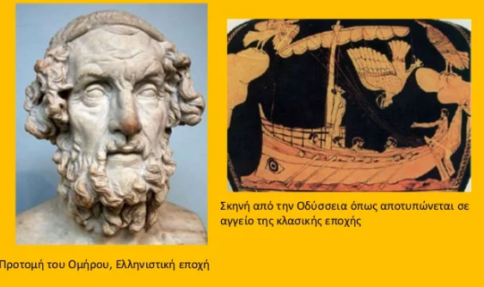
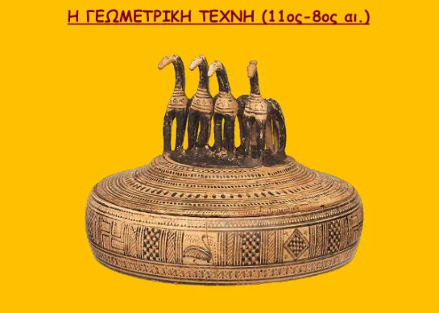
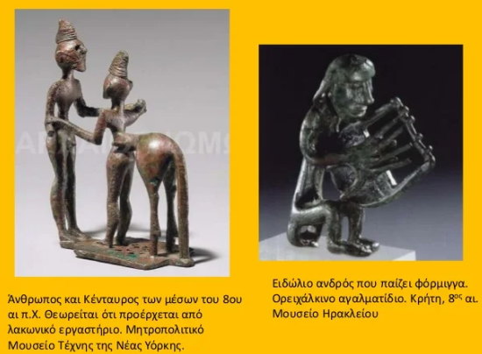
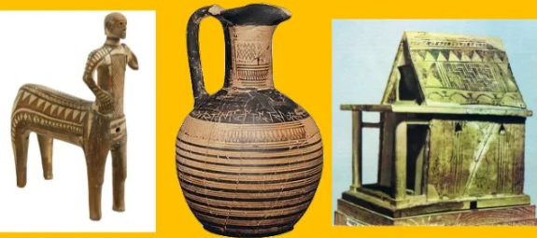
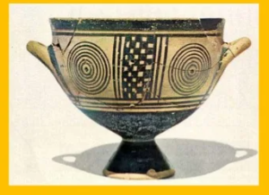
Geometric era – 1100 – 800 B.C.
12th – 11th century b.c. the fall of powerful Mycenaean states
1100 b.c. The Dorians descent
1100 – 850 b.c – population movements in Greece - Α΄ Colonization
800 – 700 b.c. The Greek Alphabet
8^{ος} century b.c. Homer – “Homeric epics”
Art in Geometric era

Slide 7
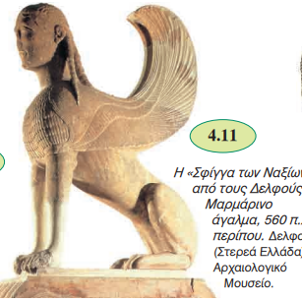
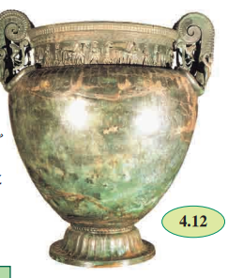
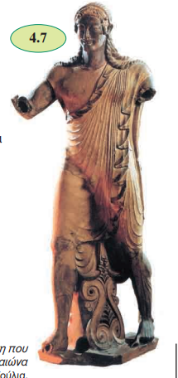
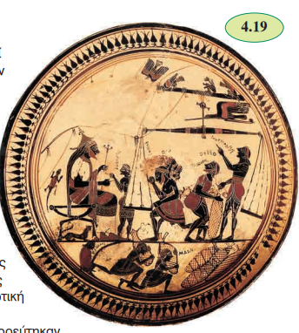
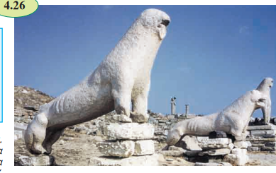
ANCIENT (ARCHAIC) GREECE – 800 – 500 π.Χ.
The term Ancient, or Archaic, Greece refers to the years 700-480 B.C.,
Κnown for its art, architecture and philosophy.
Ιs known as the age in which the ‘polis’, or city-state, was invented. The ‘polis’ became the defining feature of Greek political life for hundreds of years.
The Birth of the City-State

Slide 8
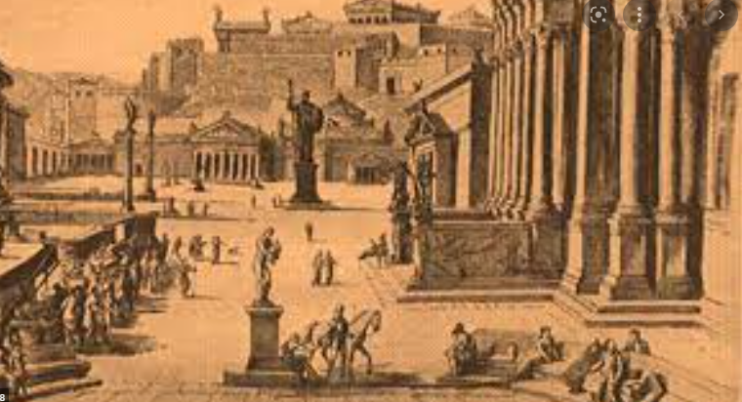
ANCIENT (ARCHAIC) GREECE – 800 – 500 π.Χ.
They developed governments and organized their citizens according to some sort of constitution or set of laws. They raised armies and collected taxes. And every one of these city-states (known as poleis) was said to be protected by a particular god or goddess, to whom the citizens of the polis owed a great deal of reverence, respect and sacrifice. (Athens’s deity was Athena, for example; so was Sparta’s.)
Εvery Greek city-state was different. The largest, Sparta, controlled about 300 square miles of territory; the smallest had just a few hundred people.

Slide 9
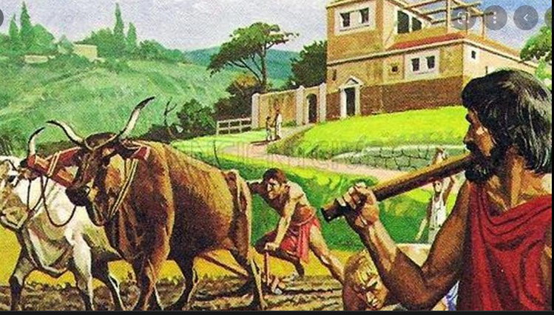
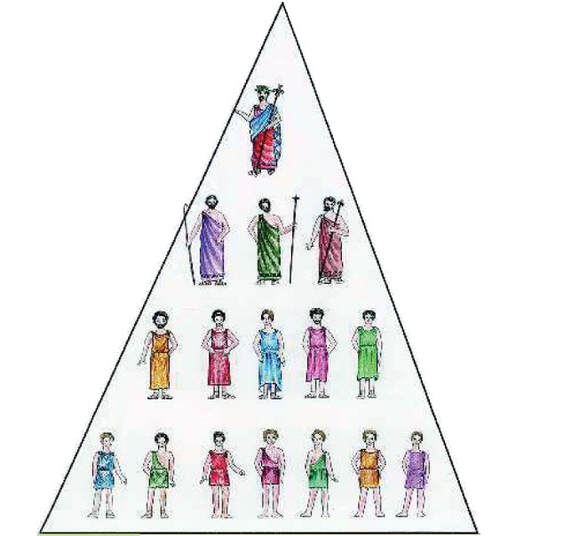
ANCIENT (ARCHAIC) GREECE – 800 – 500 π.Χ.
They all had economies that were based on agriculture, not trade: For this reason, land was every city-state’s most valuable resource.
State status: Reign – Aristocracy, Oligarchy, Tyranny, Democracy
Also, most had overthrown their hereditary kings, or basileus, and were ruled by a small number of wealthy aristocrats.
These people monopolized political power. (For example, they refused to let ordinary people serve on councils or assemblies.) They also monopolized the best farmland, and some even claimed to be descended from the Greek gods.
Reign -Aristocracy
Oligarchy
Tyranny
Democracy

Slide 10
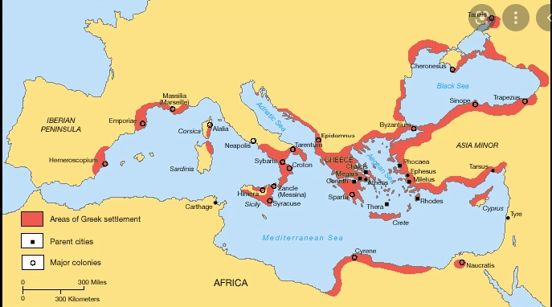
ANCIENT (ARCHAIC) GREECE – 800 – 500 π.Χ.
Colonization Β΄
Emigration was one way to relieve some of this tension. Land was the most important source of wealth in the city-states.The pressure of population growth pushed many men away from their home poleis and into sparsely populated areas around Greece and the Aegean.
Between 750 B.C. and 600 B.C., Greek colonies sprang up from the Mediterranean to Asia Minor, from North Africa to the coast of the Black Sea. By the end of the seventh century B.C., there were more than 1,500 colonial poleis.

Slide 11
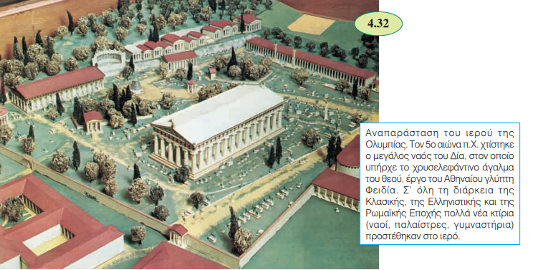
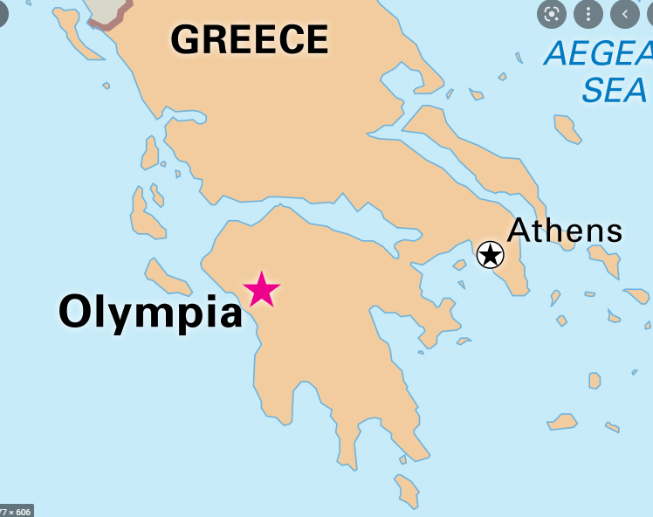
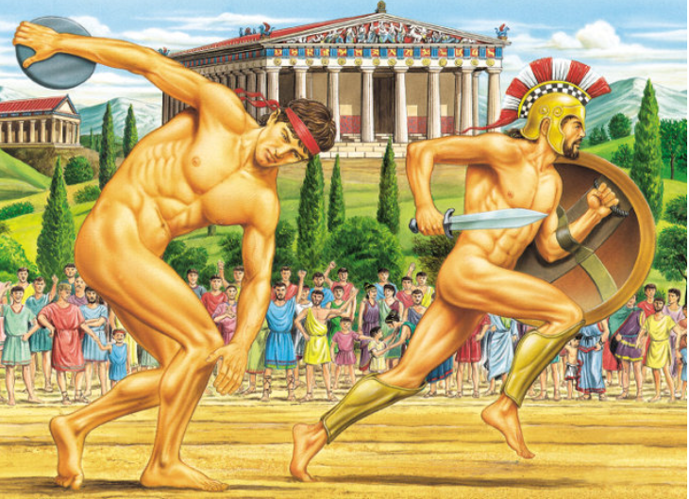
ANCIENT (ARCHAIC) GREECE – 800 – 500 π.Χ.
776 b.c. The first Olympic Games – Ancient Olympia
The Olympic Games were the oldest and most important of all games. They were the symbol of unity and a chance for cooperation amongst all Greeks. With the truce, that is stopping war while the games lasted, all the city-states sent representatives to the games. Athletes, poets, politicians, philosophers, spectators, friends and foes gathered in Olympia those days and watched the sports and other events. The Olympic Games started in 776 b.c. They took place every four years in July and according to rules women were not allowed to attend.

Slide 12
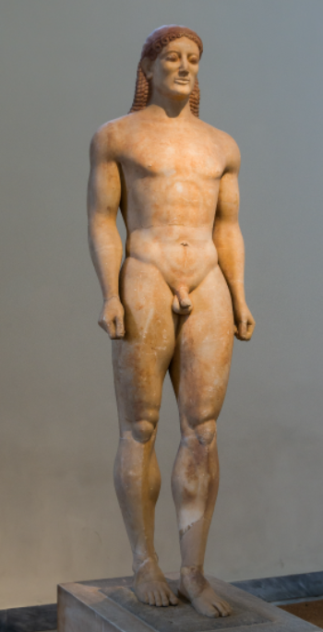
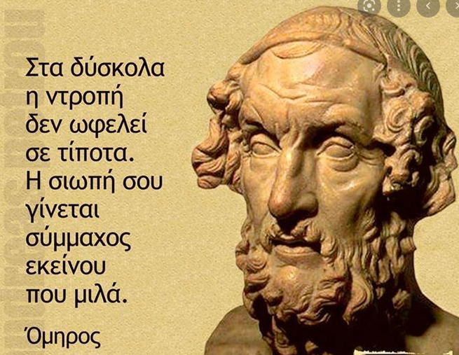
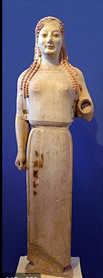
Archaic Renaissance
The colonial migrations spread Greek styles far and wide
The epic poet Homer, from Ionia, produced his “Iliad” and “Odyssey” during the Archaic period.
Sculptors kouroi and korai created.
Scientists and mathematicians made progress too: Anaximandros devised a theory of gravity; Xenophanes wrote about his discovery of fossils and Pythagoras of Kroton discovered his famous Pythagorean Theorem.

Slide 13
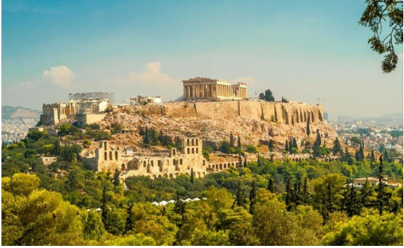
Classical Greece – 500 – 323 B.C.
The term “classical Greece” refers to the period between the Persian Wars at the beginning of the fifth century B.C. and the death of Alexander the Great in 323 B.C.
Εra of war and conflict
First between the Greeks and the Persians - Battle of Marathon - Thermopylae, Leonidas king of Sparta - Battle of Salamis (Greeks defeated Persians)
Then between the Athenians and the Spartans
But it was also an era of unprecedented political and cultural achievement.

Slide 14
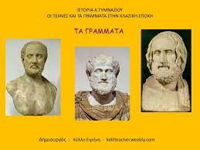
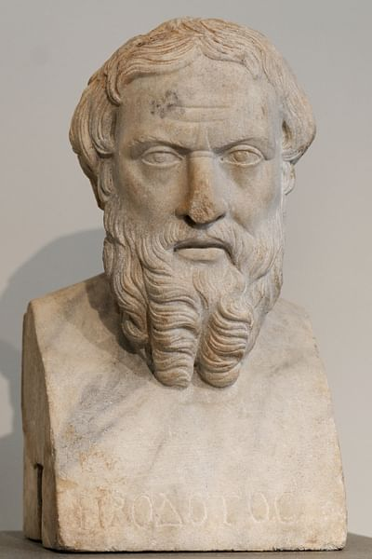
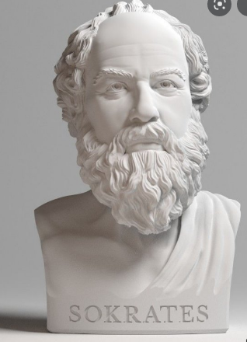
Classical Greece – 500 – 323 B.C.
Greek tragedy – Aeschylus , Sofoklis, Euripides and comedy - Aristofanis
Historian Herodotus (father of history) and Thucydides, Physician Hippokrates and the philosopher Socrates
Political reforms that are ancient Greece’s most enduring contribution to the modern world: the system known as demokratia, or “rule by the people.”

Slide 15
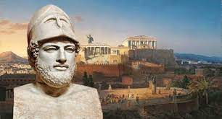
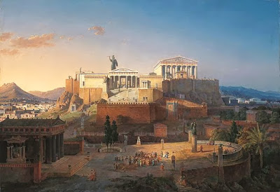
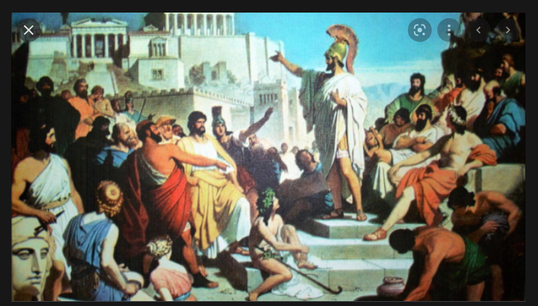
Classical Greece – 500 – 323 B.C.
«Gold Century” of Pericles
Huge growth of Athens
Art and Culture
Democracy
Agora

Slide 16
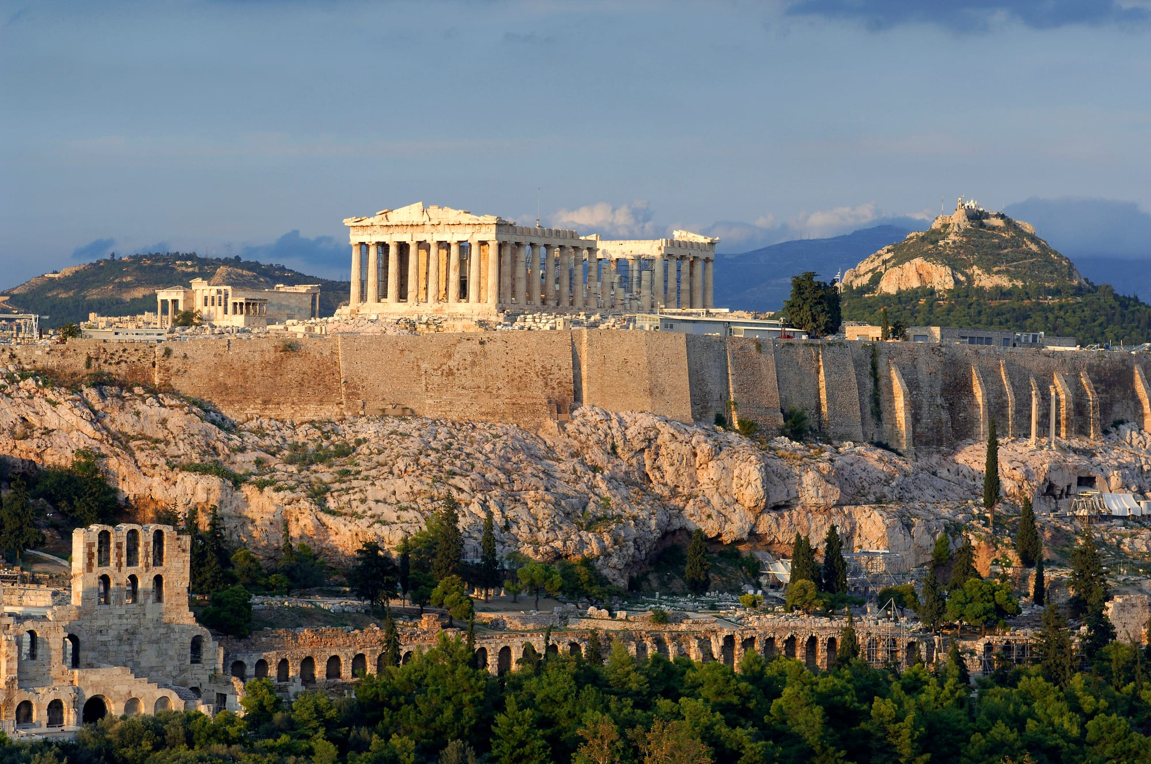
THE ACROPOLIS IN ATHENS

Slide 17
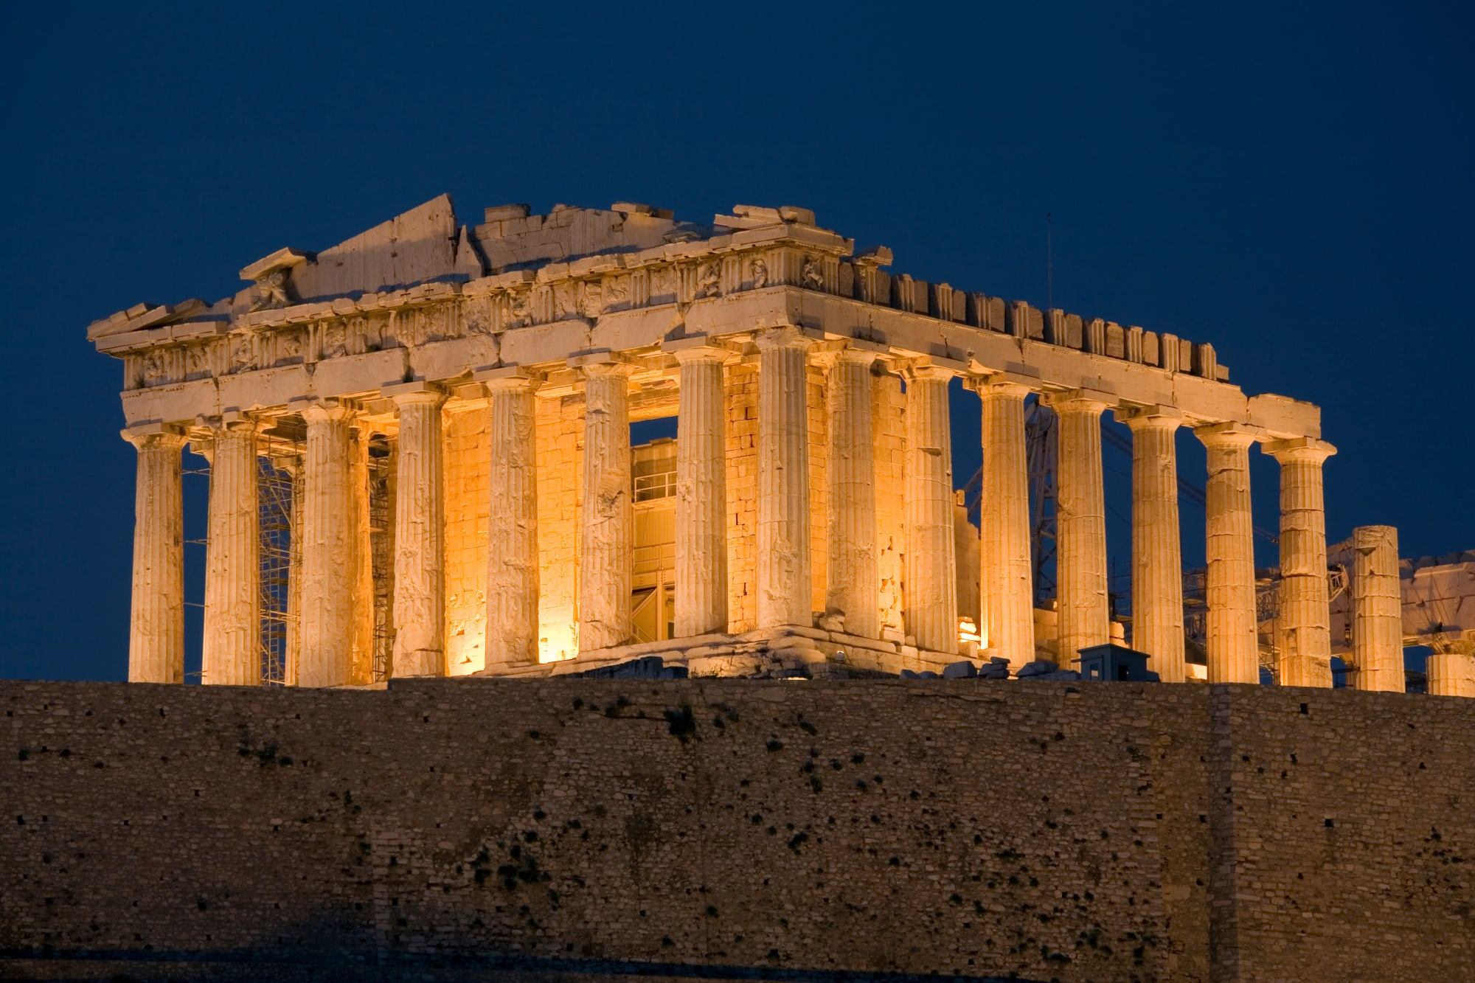
THE PARTHENON

Slide 18
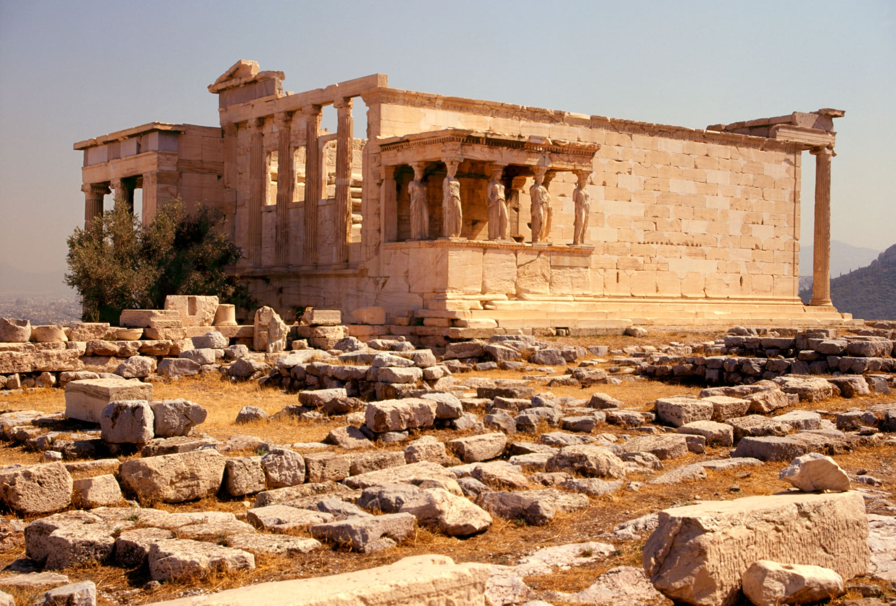
TEMPLE OF ATHENA – ATHENS

Slide 19
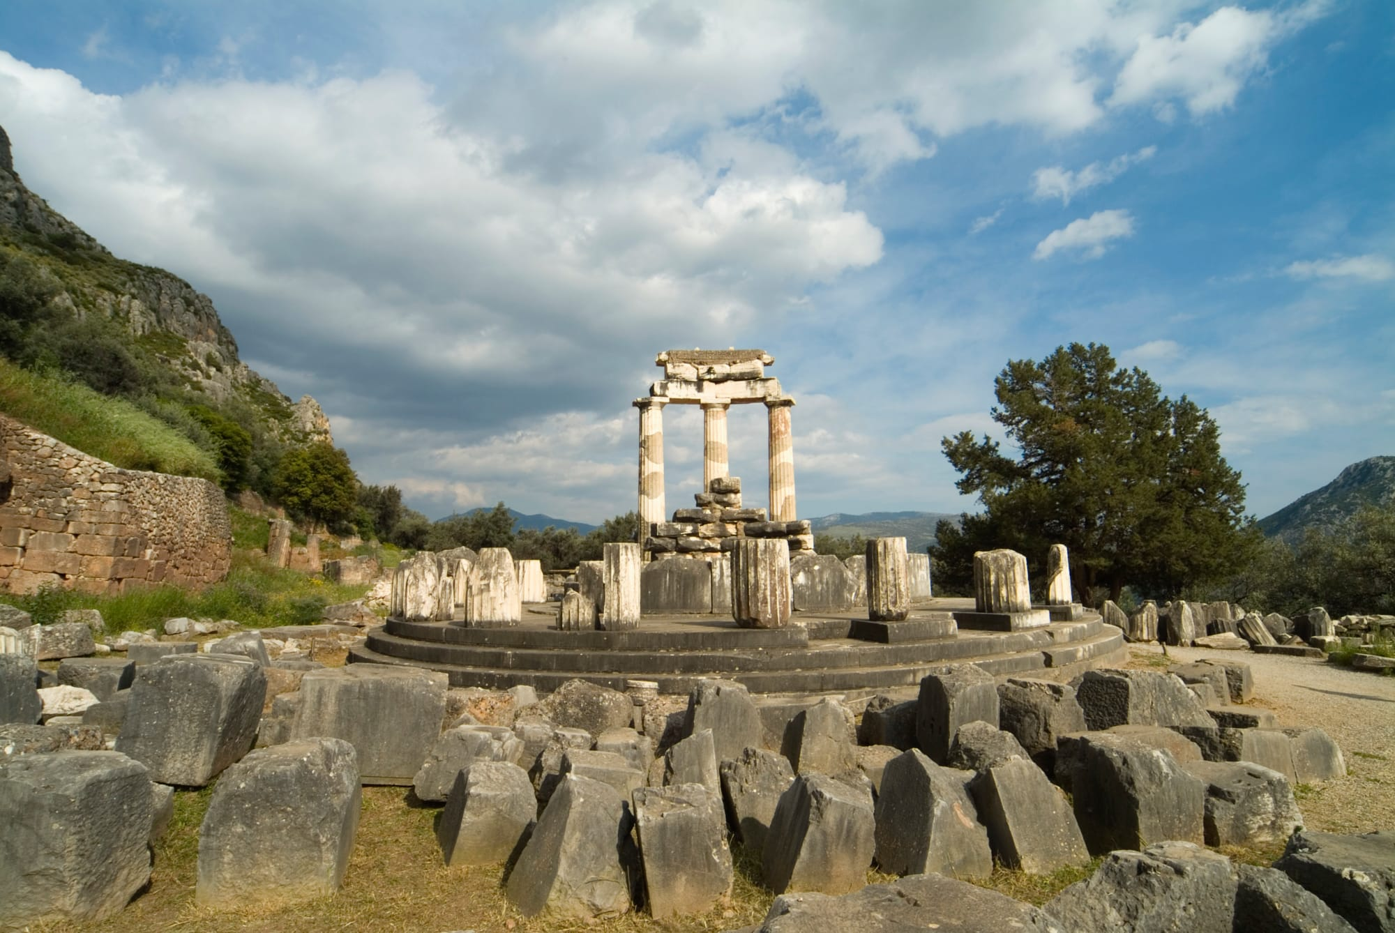
SANCTUARY OF ATHENA IN DELPHI

Slide 20
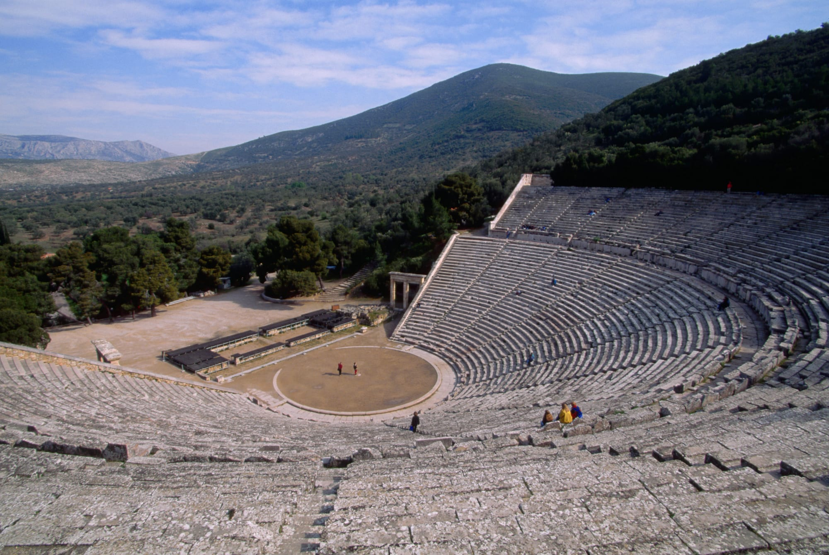
THE AMPHITHEATRE IN EPIDAURUS

Slide 21

Alexander the Great
356 – 323 B.C.
King of Macedonia
Εκστρατεία στην Ασία
He built an empire that stretched from Greece all the way to India.
Foundation of Greek cities
Spread Greek Culture

Slide 22

HELLENISTIC GREECE – 323 – 31 Β.C.
It lasted from the death of Alexander in 323 B.C. until 31 B.C., naval battle of Aktio
People started using Greek as a communication language.
Constant fights, competition and war between Hellenistic states weakened their economy. Romans took advantage of this situation.

Slide 23

Ει θεοί διαλέγονται, την των Ελλήνων γλώττη χρώνται
Cicero said “ When Gods talk, they use the Greek language”

Slide 24

The Greek History

Slide 25

Why is Ancient Greece important?
The political, philosophical, artistic, and scientific achievements of ancient Greek civilization formed a legacy with unparalleled influence on Western civilization. Greek political ideas have influenced modern forms of government, Greek pottery and sculpture have inspired artists for millennia, and Greek epic, lyric, and dramatic poetry is still read around the world.
BRITANNICA

