Slide 1
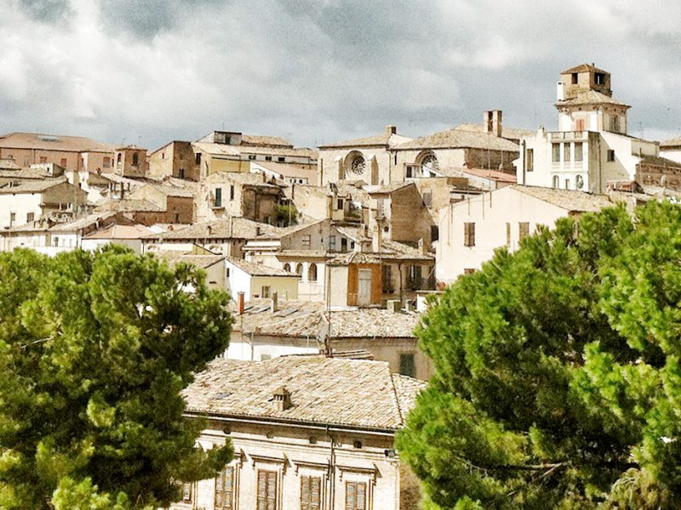
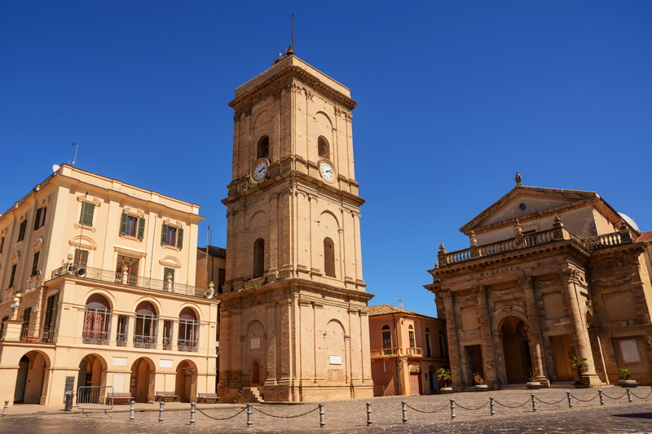
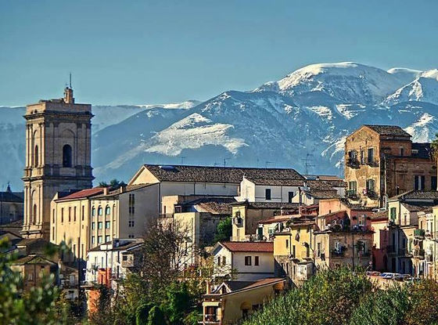
MY HOMETOWN: LANCIANO

Slide 2
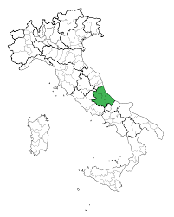
Where is Lanciano?
Lanciano in Abruzzo, in the center of Italy. It is a small town, but not boring for that!
It is between the mountains and the sea, so you can go wherever you want!

Slide 3
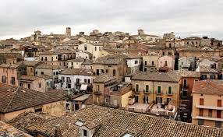
Something about the history of Lanciano…
The legend sais that Solima, and his mate, Enea, went in Italy in 1179b.c, and after the fall of Troy they called this city anxanum. But in reality we know that Lanciano already existed from the Neolithic!

Slide 4
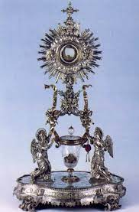
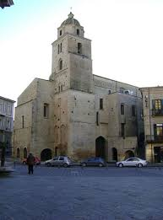
What should I visit when I go in Lanciano?
First of all, you should defenitly visit the sanctuary of the eucharistic miracle. It is in «corso Roma» in the curch of San Francesco.

Slide 5
What should I visit when I go in Lanciano?
Another place to visit is the storic centre. It’s divided in four storic neighborhoods, everyone with his own flag:
Lancianovecchia
Civitanova
Sacca
Borgo

Slide 6
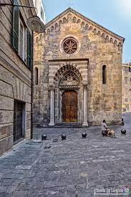
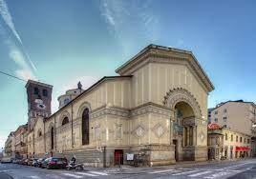
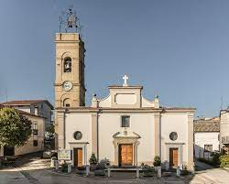
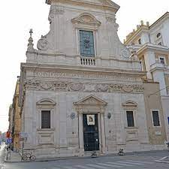
What should I visit when I go in Lanciano?
You can also visit a lot of churchs such as:
Basilica
-Curch of Santa Giusta
-Cucrch of San Donato
-Curch of la Madonna degli Angeli
-Church of Maria SS.ma dell'Iconicella
-Church of la Madonna del Pozzo

Slide 7
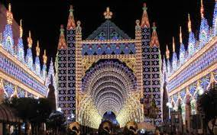
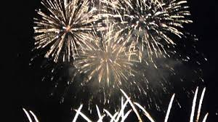
Festivities in Lanciano
There are a lot of festivities in Lanciano, but the most famous are the MASTROGIURATO «september festivities». They comprend things like the «nottata», when you stay awake until 4 a.m. to see the fireworks. Or the procession.
Something I really love about this period are the lights! They are all around the city and they are beautiful! Another thing I like are the rides that are there, I love them!

Slide 8
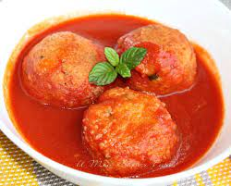
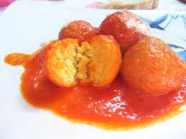
Typical dishes in Lanciano
There aren’t much tipical dishes in Lanciano, but they are delicious! You can eat the «pallotte cacio e ova», meetaballs made of cheese.

Slide 9
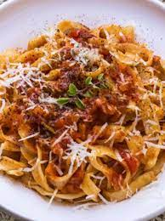
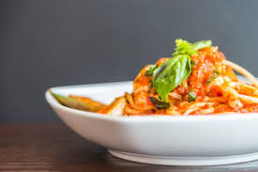
Typical dishes in Lanciano
You can also try the «rintrocilo» a kind of pasta made only with water and flour, and they are usually eaten with ragù.

Slide 10
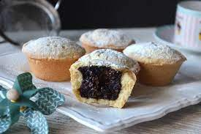
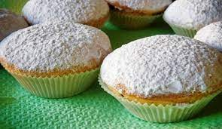
Typical dishes in Lanciano
If you want to eat something sweet instead, you can eat the bocconotti! They are sweets made of shortcrust pastry and inside of them there is chocolate or marmelade.

Slide 11
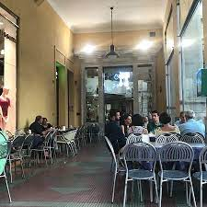
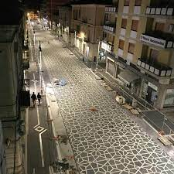
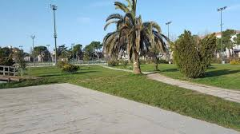
If I have any free time, where should I go?
It depends by what you want to do, but you can go in the centre of the city, ‘cose there there are a lot of shops, bars, pubs, parks and you can even go for a walk!

Slide 12
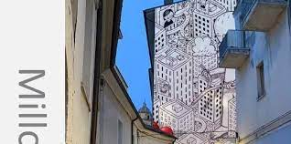
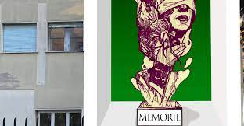

Street art in Lanciano
In the last months a famous street art artist famous all over the world, Millo, drawed a murales on the wall of the Fenaroli theatre and on the walls of some schools.

Slide 13
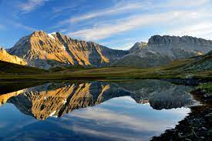
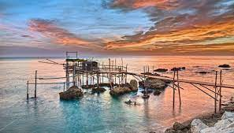
Some places near Lanciano that you can visit
Abruzzo is also famous for the trabocchi coast, and Lanciano is quite near to it. It takes twenty minutes, so you can visit the coast without problems!
But if you don’t like the sea no problem! You can go in mountain as well. Is further from Lanciano than the trabocchi coast, but you can enjoy a day in nature.

Slide 14
Thank you for your attention, I hope to see you here!

